Slide 1
SCHOOL Billing SYSTEM in ‘C’ Language
Submitted By:
Name: Garvesh garg
UID: 21MCI1222

Slide 2
Contents:
Introduction of the project
Cost analysis
Project category
Features of the Project.
Platform, Hardware and Software requirement specification.
Output Screenshots

Slide 3
Introduction:
A System can work smoothly if and only if all parts are working according to schedule or given predefined standards.
So, I have developed the software for a “School Billing System”.
I am representing a computer base “School Billing System” to reduce all errors or problems that are arises in the manual billing system in schools.
It works in an organizational manner.
It can properly managed fee/salary and all the information about the student/Teacher/Staff .

Slide 4
Cost Analysis:
Hardware Cost:
Hardware cost relate to the actual purchase or lease of the computer & peripherals Ex. Printer, disk, CD drive etc.
The best way to control for this cost is to treat it as an operating cost.
Personnel Cost
This includes staff salaries & benefits (health insurance, vocation time, sick pay etc.) as well as pay for those involved in developing system.
And many more costs like Facility, Supply, Equipment Costs etc.

Slide 5
Project category:
This project is in ‘C’ language.
In this project, we perform billing or accounting operations under two account types:
one for the students and
another for teachers and staffs.
School Billing System is a console application without graphic.
The source code for this project is over 1000 lines.

Slide 6
Features of project:
we can add, record, modify, search and delete the records of both account types.
It allows you to display fees, dues, total and advance of students, and salary-related information of teachers and staffs.
For the entry of records, current date and month is asked.
Then, you can select the account type, and perform billing operations
Then record, Name, Class and Roll No. of the student is asked, and it is similar for all other functions as well as the teacher’s account.

Slide 7
Platform, Hardware and Software requirement specification:
Processing Environment:
The project runs on every type of OS like Windows XP, 7, 8, 10, Mac OS etc.
Configuration:
At least 60 GB Hard Disc, 512 MB RAM, Pentium ¾.
Language:
‘C’ Language.
Editors:
Visual Studio/Dev C++/Turbo C/C++.

Slide 8
OUTPUT SCREENSHOTS

Slide 9
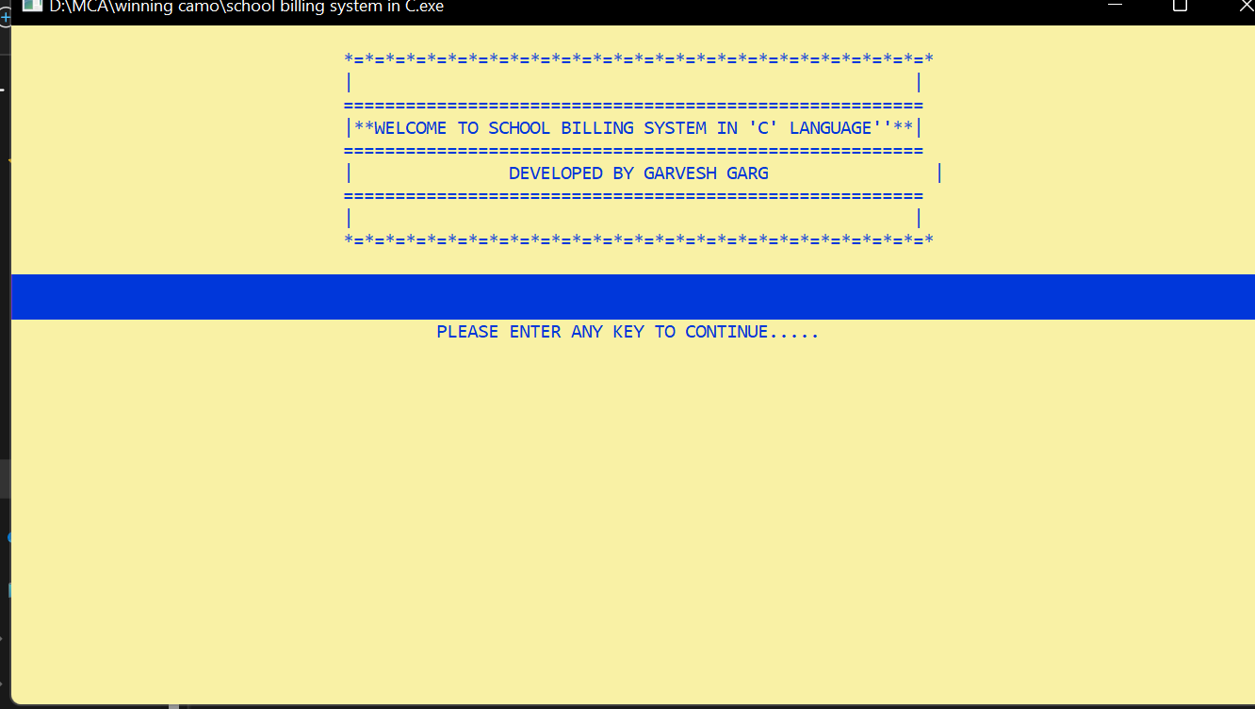

Slide 10
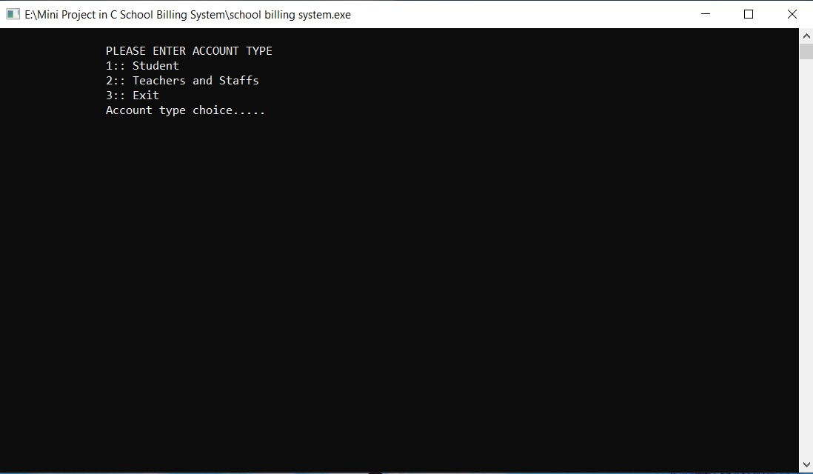

Slide 11
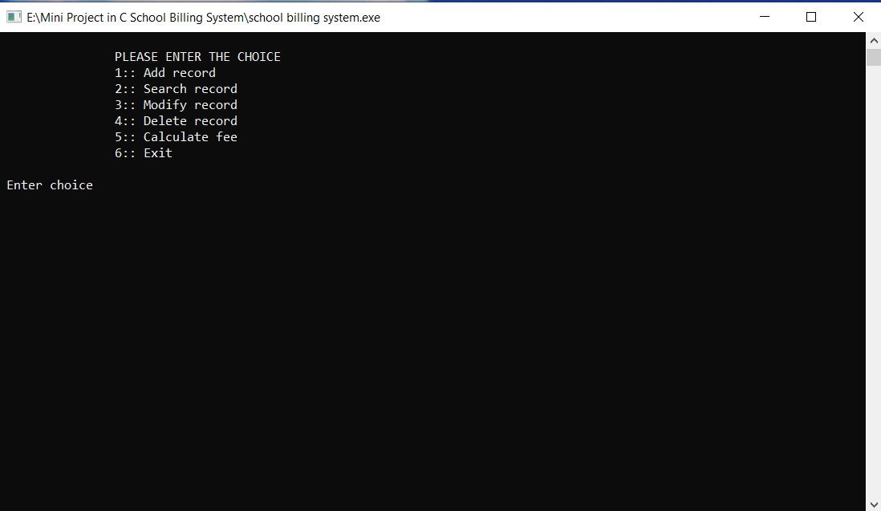

Slide 12
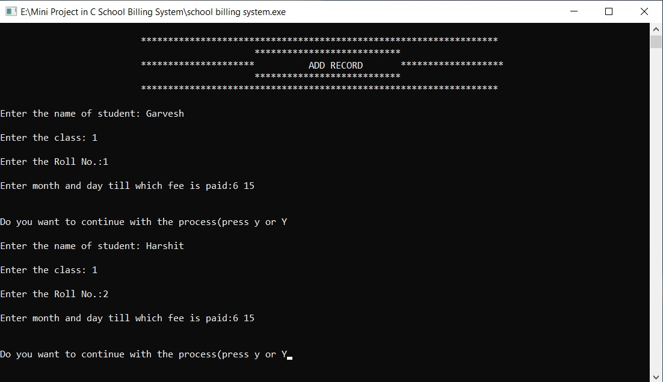

Slide 13
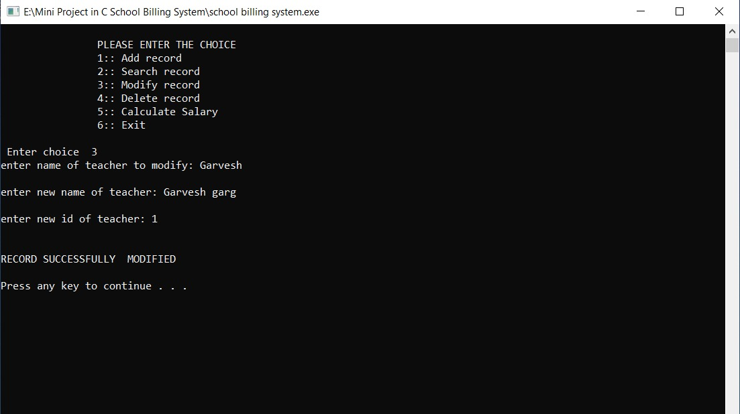

Slide 14
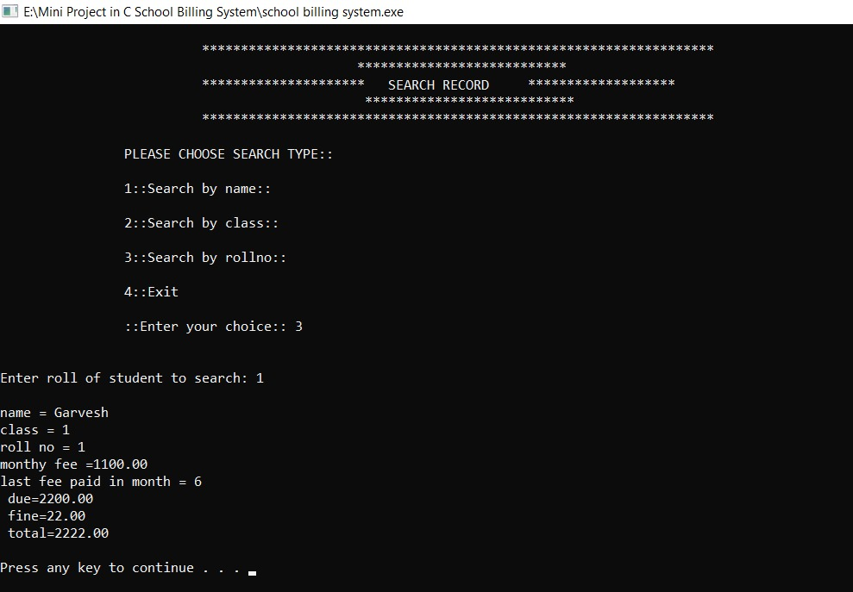

Slide 15
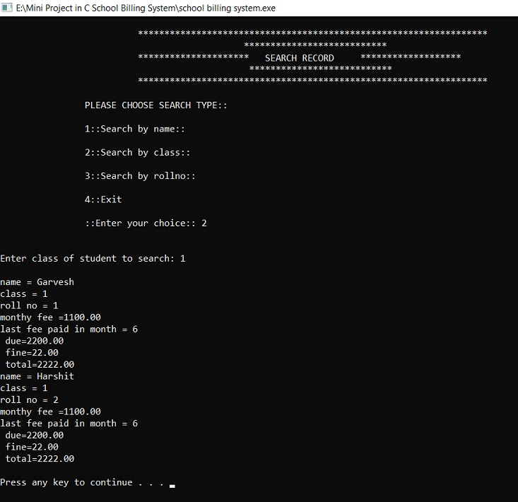

Slide 16
Thank You

